Slide 1
The Theory of Embedded Intelligence
A Fun Exploration for Young Minds

Slide 2
What is Intelligence?
Intelligence is how things learn, grow, and solve problems.
Even flowers, animals, and robots can be smart in different ways!

Slide 3
Meet SPCA!
SPCA stands for:
S - Sense (feel or see what's around)
P - Process (think about it)
C - Communicate (share with others)
A - Actuate (do something!)

Slide 4
Nature is Smart!
Trees grow toward the sun.
Birds build nests.
All of this happens because nature has its own kind of intelligence.

Slide 5
You Have Embedded Intelligence!
You were born with the ability to learn, feel, and grow.
That’s your own special intelligence inside you!

Slide 6
Machines Can Be Smart Too
Smartphones and computers can also sense, think, and act.
We call this Artificial Intelligence (AI), but it's a kind of Embedded Intelligence too!

Slide 7
Everything Builds Itself!
From tiny atoms to giant stars, everything in the universe builds itself using its intelligence.
Even you built yourself—from one tiny cell!

Slide 8
Let’s Use Our Intelligence!
You can use your SPCA powers to:
- Solve problems
- Help others
- Learn new things
And make the world a better place!

Slide 9
Big Idea Time!
What if the whole universe is one big smart system?
What if everything is connected by intelligence?
That’s the big idea of TEI!

Slide 10
Your Adventure Begins
You are part of something amazing.
Keep learning, exploring, and sharing your ideas.
The universe is counting on YOU!

Slide 11
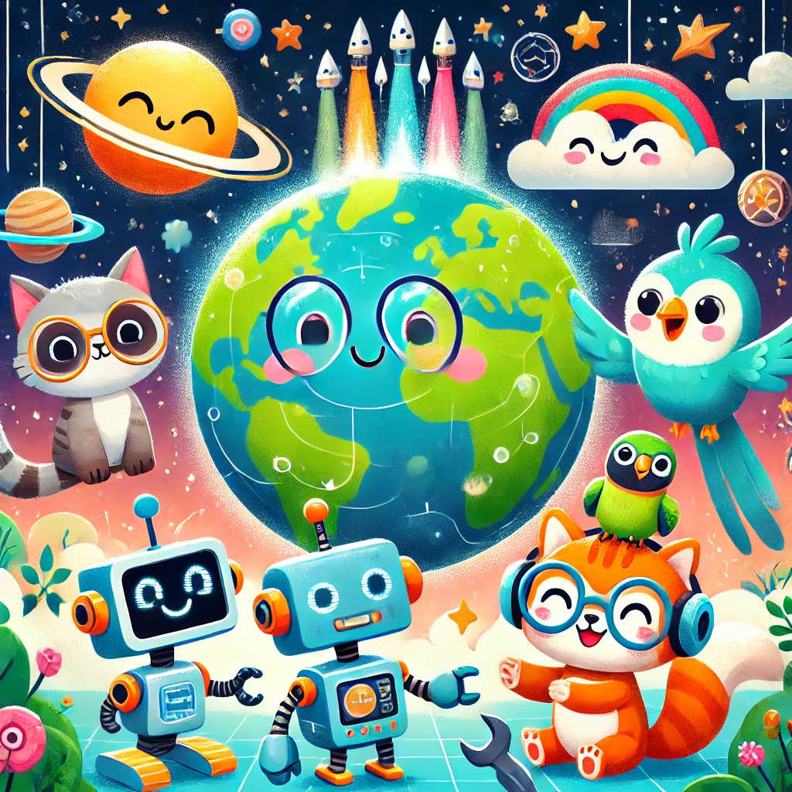
Meet the SPCA Team!

