Slide 1

Caution!!
Caution: Much like studying consciousness, contemplating, studying or applying The Theory of Embedded Intelligence (TEI) will change your life. This Theory is a revolution in all areas of contemplation, all sciences and all practical applications of The Theory.
The Theory (TEI) causes one to reconsider one’s beliefs and what one knows about oneself and one’s worldview.
www.WDC65xx.com & www.TheMenschFoundation.org
Copyright 2010-2024 The Western Design Center, Inc. All rights reserved.

Slide 2
Revolutions
The following quote is from:
The Structure of Scientific Revolutions page 90 Third Edition 1996
By: Thomas S. Kuhn (paradigm shift)
“Almost always the men who achieve these fundamental inventions of a new paradigm have been either very young or very new to the field whose paradigm they change.”
www.WDC65xx.com & www.TheMenschFoundation.org
Copyright 2010-2024 The Western Design Center, Inc. All rights reserved.

Slide 3
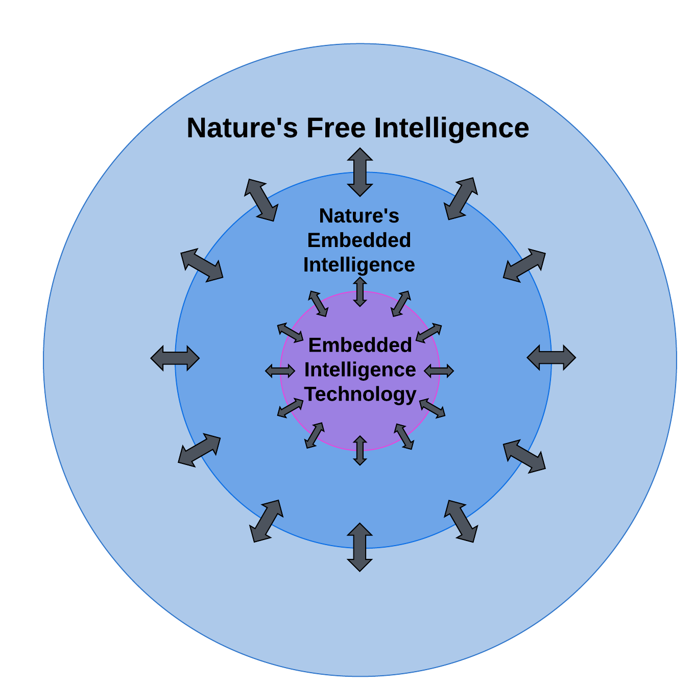
Model of Intelligence
Mensch Intelligence Model – Spacetime Intelligence
Nature’s Free Intelligence exists outside of spacetime.
www.WDC65xx.com & www.TheMenschFoundation.org
Copyright 2010-2024 The Western Design Center, Inc. All rights reserved.

Slide 4
Consciousness
EIT can Sense, Process, Communicate and Actuate (SPCA).
SPCA could be considered Objective Consciousness (OC).
Most philosophical use of the word “consciousness” is considered Subjective Consciousness (SC).
EIT’s SPCA augments human SPCA producing Augmented Objective Consciousness (AOC).
Humans have designed Autonomous Machines (AM) with abilities to SPCA for Autonomous Machine Objective Consciousness (AMOC).
www.WDC65xx.com & www.TheMenschFoundation.org
Copyright 2010-2024 The Western Design Center, Inc. All rights reserved.

Slide 5
The Theory
A theoretical law is a law that analyzes and connects empirical studies to define or advance a theoretical position.
The Theory of Embedded Intelligence (TEI)
The 1st Law of The Theory states that Intelligence wants to know itself through an infinite continuum and collection of phenomena including you and me.
The 2nd Law of The Theory states that Intelligence is gained through embedded experiences and is not lost through a destructive experience - becoming free once again - changing to and from free and embedded states.
The 3rd Law of The Theory states that Intelligence increases the number of use cases and complexity with time.
www.WDC65xx.com & www.TheMenschFoundation.org
Copyright 2010-2024 The Western Design Center, Inc. All rights reserved.

Slide 6
Intelligence Defined
Nature’s Free and all Embedded Intelligence is characterized as the ability to sense, process, communicate, and actuate (SPCA) based upon information gained from an understanding of itself and others for the benefit of many.
Nature uses embedded intelligence to self-assemble all things aka phenomena observed.
www.WDC65xx.com & www.TheMenschFoundation.org
Copyright 2010-2024 The Western Design Center, Inc. All rights reserved.

Slide 7
Applied Intelligence
The Infinite Universe (IU) began as an infinite Free Intelligence (FI).
Free means not embedded.
Intelligence first created coherent quanta energy wave forms.
Intelligence creates subatomic particles through the process called decoherence.
Entanglement can be thought of as intelligently connected quantum bits – qubits with opposite spins or information bits – 1 and 0 values.
It is now thought that the speed of Intelligence is infinite.
All things in nature have used Intelligence to create the observed phenomena through self-assembly – atoms build atoms – you build you – I build me.
Life begins and evolves anywhere conditions are available through the Collective Intelligence of abiotic matter.
www.WDC65xx.com & www.TheMenschFoundation.org
Copyright 2010-2024 The Western Design Center, Inc. All rights reserved.

Slide 8
Evolution
All abiotic and biotic matter began from Free Intelligence (FI).
When matter is destroyed, the 2nd Law of The Theory states that all EI becomes FI once again.
These cycles of FI and EI contribute to evolution in nature.
It is possible that EI can contribute to FI as shown in the 3rd slide’s bidirectional arrows in the graphical Model of Intelligence.
Human made technology has evolved in a similar way.
www.WDC65xx.com & www.TheMenschFoundation.org
Copyright 2010-2024 The Western Design Center, Inc. All rights reserved.

Slide 9
Intelligence Evolution
Nature’s Intelligence Evolution
Collective Quanta Evolution
Collective Atomic Evolution
Collective Mineral Evolution
Molecular Evolution
Cellular Evolution
Living Systems Evolution
www.WDC65xx.com & www.TheMenschFoundation.org
Copyright 2010-2024 The Western Design Center, Inc. All rights reserved.

Slide 10
Intelligence Evolution
The Human Collective Intelligence Evolution
Collective Intelligence see Wikipedia.
Creation Myth Method
Philosophical Method
Scientific Method
Engineering Method
Systems Engineering
www.WDC65xx.com & www.TheMenschFoundation.org
Copyright 2010-2024 The Western Design Center, Inc. All rights reserved.

Slide 11
Human Intelligence
Consider the following in an average human brain:
There are approximately 20 billion neurons with an average of 7000 synapses per neuron for 140 trillion synapses.
Microtubules are abundant in neurons. Microtubules may be part of the neuron and synapsis ANN processing.
Human-bounded infinite Intelligence can collectively create an infinite number of possible Intelligence use cases and outcomes.
Think Human Quantum Supremacy
www.WDC65xx.com & www.TheMenschFoundation.org
Copyright 2010-2024 The Western Design Center, Inc. All rights reserved.

Slide 12
Collective Intelligence
Consider the Collective Intelligence of a human. The current best estimate is that an average human body contains about 37 trillion cells, each with an Embedded Intelligence to self-assemble. There are more cells making up one human body than the number of seconds in one million years and about 370 times the number of stars in the Milky Way.
The Body Electric book by Robert O. Becker, M.D. and Gary Selden (1985) was expanded by Michael Levin’s research work as shown in this amazing 19:40 minute TED video.
www.WDC65xx.com & www.TheMenschFoundation.org
Copyright 2010-2024 The Western Design Center, Inc. All rights reserved.

Slide 13
Intelligence Evolution
Scientific Intelligence Evolution
Classic Physics Understanding Evolution
Quantum Physics Understanding Evolution
Merging Emerging Physics Evolution
Augmenting AI+EI the new paradigm
Aristotle-Kant-mensch Evolution
Human – integrity and honor
Democracy – collective human intelligence
www.WDC65xx.com & www.TheMenschFoundation.org
Copyright 2010-2024 The Western Design Center, Inc. All rights reserved.

Slide 14
Microprocessors
Microprocessors are the core processing element of all embedded intelligence technologies (EIT).
Almost all early home and game computers were 8-bit microprocessors. Now almost all smart-phones, tablets, Apple and Nvidia AI processors are powered by 32/64-bit ARM ISA processors.
Learning about and using EIT for sensing, processing, communicating and actuating (SPCA) is the key to understanding yourself, others and the Universe.
www.WDC65xx.com & www.TheMenschFoundation.org
Copyright 2010-2024 The Western Design Center, Inc. All rights reserved.

Slide 15
Machine Intelligence
The following quote was AI Generated:
“Machine intelligence (MI) is a type of advanced computing that allows machines, devices, or algorithms to interact with their environment intelligently. It's a form of artificial intelligence (AI) that enables machines to learn, solve problems, and prioritize tasks, which can help them achieve their goals.”
www.WDC65xx.com & www.TheMenschFoundation.org
Copyright 2010-2024 The Western Design Center, Inc. All rights reserved.

Slide 16
Personal Cosmology
Philosophy of Cosmology
From above link:
“Cosmology (the study of the physical universe) is a science…”
“The uniqueness of the Universe: there exists only one universe, so there is nothing else similar to compare it with, and the idea of “Laws of the universe” hardly makes sense.”
“Cosmology deals with the physical situation that is the context in the large for human existence: the universe has such a nature that our life is possible.”
The Desiderata
From above link:
“You are a child of the universe,
no less than the trees and the stars…”
www.WDC65xx.com & www.TheMenschFoundation.org
Copyright 2010-2024 The Western Design Center, Inc. All rights reserved.

Slide 17
Honors Education
The Human Event
From following embedded link:
“Honors education is characterized by in-class and extracurricular activities that are measurably broader, deeper, or more complex than comparable learning experiences typically found at institutions of higher education.
Honors experiences include a distinctive learner-directed environment and philosophy, provide opportunities that are appropriately tailored to fit the institution's culture and mission, and frequently occur within a close community of students and faculty.”
www.WDC65xx.com & www.TheMenschFoundation.org
Copyright 2010-2024 The Western Design Center, Inc. All rights reserved.

Slide 18
Imagination
Imagination is the ability to form mental images of things or events that are not present to the senses.
Imagine that one Big Bang was not the starting point for the observable part of the IU to exist.
Imagine “Intelligence” changed the IU from a static IU to a dynamic IU - a changing and evolving IU beginning with energy quanta.
Imagine an increasing Intelligence in you.
Imagine a collectively understood IU through interdisciplinary science.
www.WDC65xx.com & www.TheMenschFoundation.org
Copyright 2010-2024 The Western Design Center, Inc. All rights reserved.

Slide 19
EIT vs CI/AI/MI/ML
Embedded Intelligence Technology (EIT) is built with computer or microprocessor hardware and software.
EIT also refers to Computer Intelligence (CI), Artificial Intelligence (AI), Machine Intelligence (MI) and Machine Learning (ML).
Computer Intelligence (CI) was named Artificial Intelligence (AI) by John McCarthy and others at Dartmouth in 1956.
A confusing definition of “artificial” is false. When used with Intelligence could mean Intelligence based upon false information or false processing or unsupported beliefs or unscientific beliefs.
www.WDC65xx.com & www.TheMenschFoundation.org
Copyright 2010-2024 The Western Design Center, Inc. All rights reserved.

Slide 20
Learning from Nature
Biomimicry is a research field that involves studying and adapting natural models, systems, and elements to solve human problems and create opportunities. The term comes from the Greek words bios meaning “life” and mimesis meaning “imitation”.
Embedded Intelligence Technology (EIT) is a branch of computer science and engineering (CSE) that mimics Intelligence found in nature.
www.WDC65xx.com & www.TheMenschFoundation.org
Copyright 2010-2024 The Western Design Center, Inc. All rights reserved.

Slide 21
Neural Networks (NN)
Geoffrey Hinton and others, in the 1980’s, defined, conceptualized and created small digital neural networks (DNN) on 8-bit Apple II computers.
During forward propagation, information is fed into the neural network, and the network calculates the output. During backward propagation, the error between the predicted output and the actual output is calculated, and the weights and biases of each neuron are adjusted to reduce the error.
Your brain, a massively parallel analog neural network (ANN) uses watts of power.
Today Nvidia arm9 microprocessor powered DNNs use megawatts of power.
DNNs are used for a variety of generative AI Embedded Intelligence Technology (EIT) use cases.
www.WDC65xx.com & www.TheMenschFoundation.org
Copyright 2010-2024 The Western Design Center, Inc. All rights reserved.

Slide 22
Learning from EIT
Reverse biomimetics is a relatively new process that involves transferring knowledge from Machine Intelligence back to biology. An example of reverse biomimetics is transferring what we know about digital neural networks to understanding our brain’s analog neural networks.
The Theory uses the perspective derived from understanding EIT to reverse engineer all things in the Universe.
www.WDC65xx.com & www.TheMenschFoundation.org
Copyright 2010-2024 The Western Design Center, Inc. All rights reserved.

Slide 23
AHI vs AM
EIT can offer suggestions for our Individual and Collective Intelligence. We call this combination Augmented Human Intelligence (AHI).
Autonomous Machines (AM) are equipped with EIT that make decisions independent of humans.
The evolution of EIT has provided machines with Intelligence that can harm humans.
AHI has maintained a balance of human good and bad acting use of AM (e.g. drone warfare).
www.WDC65xx.com & www.TheMenschFoundation.org
Copyright 2010-2024 The Western Design Center, Inc. All rights reserved.

Slide 24
Discussion Topics
Speed of Intelligence
What is the speed of communications with entangled qubits?
Can the speed of entanglement be measured?
Could the speed of Intelligence be infinite?
Could nature’s life on Earth intercept, decode and understand nature’s Intelligent communications from distant star systems?
The intelligence model suggests that only nature can communicate with the infinite Intelligence of the IU.
Could EIT intercept, decode and understand communications from distant star systems?
www.WDC65xx.com & www.TheMenschFoundation.org
Copyright 2010-2024 The Western Design Center, Inc. All rights reserved.

