Slide 1
Worldwide Mensch EIT Award
©2019 The Bill and Dianne Mensch Foundation, Inc.
All rights reserved.
TheMenschFoundation.org

Slide 2
About the Foundation
Mission Statement:
The Bill and Dianne Mensch Foundation provides information and technology for enriching learning about Computer Science & Engineering (CSE) and its relationship to Electrical and Computer Engineering (ECE) and Embedded Systems (ES) as well as the more general topic of application specific Embedded Intelligence (EI).

Slide 3
About the Worldwide EIT Award
The Worldwide Mensch EIT Award for Best Use of WDC’s Embedded Intelligence Technology (EIT) Award is an annual award that recognizes the engineering innovation team that best integrates any WDC EIT product (in board or chip form) into a potential commercial product that was developed in a senior design project. Specifically, the award will be granted to a student team that has built a smart connected prototype that may have a commercial market.
Worldwide eligibility
Self-Nominated Award – Download Form Here
Prize amount - $1000
Judged and Awarded by The Western Design Center, Inc.

Slide 4
Self Nomination Form
Worldwide Best Use of WDC’s Embedded Intelligence Technology (EIT)
Sponsor: The Western Design Center, Inc.
Description: The worldwide WW Mensch EIT Award for Best Use of WDC’s Embedded Intelligence Technology (EIT) Award is an annual award that recognizes the engineering innovation team that best integrates any WDC EIT product (in board or chip form) into a potential commercial product that was developed in a senior design project. Specifically, the award will be granted to a student team that has built a smart connected prototype that may have a commercial market. Embedded Intelligence is characterized as the ability of a product to sense, process, communicate, and actuate (SPCA) based upon information gained from understanding of both itself and others and for the benefit of many. Preference will be given to designs with SPCA capabilities that can demonstrably surpass human abilities to perform the same function. Background: Embedded Intelligence (EI) is defined and used here to include the combination of software and micro-processing hardware used in Industry 4.0 and beyond Embedded Systems, Intelligent Systems and/or characterized as having Artificial Intelligence. Application specific embedded intelligence is used in a wide range of solutions in products like microwave ovens, refrigerators, pacemakers, smartphones, automobiles, robots, drones, and airplanes. The most common feature of these products, which fall into the category of “Internet of Things (IoT)” is that they communicate with each other (increasingly through what is described as “cloud services,” which constitutes a higher level of intelligence).
Award Amount: $1000
Self-nomination requirements: Provide justification in the space below for how your project deserves to win this award (two pages max). Provide details on the embedded system used and how it was integrated with the rest of the system. The justification should include a brief description of what was sensed, processed, communicated, and actuated in the system designed in the project. In addition, in keeping with entrepreneurial aspects of the Mensch Prize, the document must include a statement on the innovative value of the designed system to mankind. The following 6 questions need to be answered in the Justification section: Market identification for name of product first introduced on date. WDC EIT used in the product. Prototype/developer model sales price. Prototype/developer model unit sales volume to date. Projected production sales price. Projected production annual unit sales volume.
Self-Nomination
Team Name (If Applicable):
Project Title:
Project Description :
Justification:
Additional Material Attached:
Submitted by (name, email):

Slide 5
More about EI
Embedded Intelligence (EI) - The combination of software and micro-processing hardware used in Industry 4.0 and beyond Embedded Systems, Intelligent Systems and/or characterized as having Artificial Intelligence.
Embedded Intelligence is characterized as the ability of a product to sense, process, communicate, and actuate (SPCA) based upon information gained from understanding of both itself and others and for the benefit of many.
TheMenschFoundation.org Website – Learn EI Section
The Theory of EI
Universities with EI Programs
Reflections on EI
EI Glossary/Reading List/Q&A

Slide 6
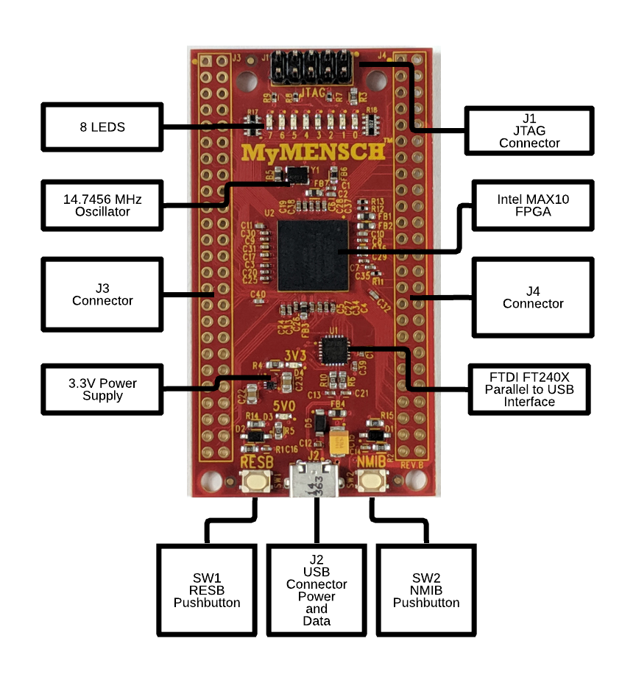
Embedded Intelligence Technology
Example – MyMENSCH SBC from WDC
Single Board Computer with MAX10 FPGA
WDC’s 65xx FPGA Microcontroller embedded in FPGA
2x 50 pin connectors for rapid prototyping

Slide 7
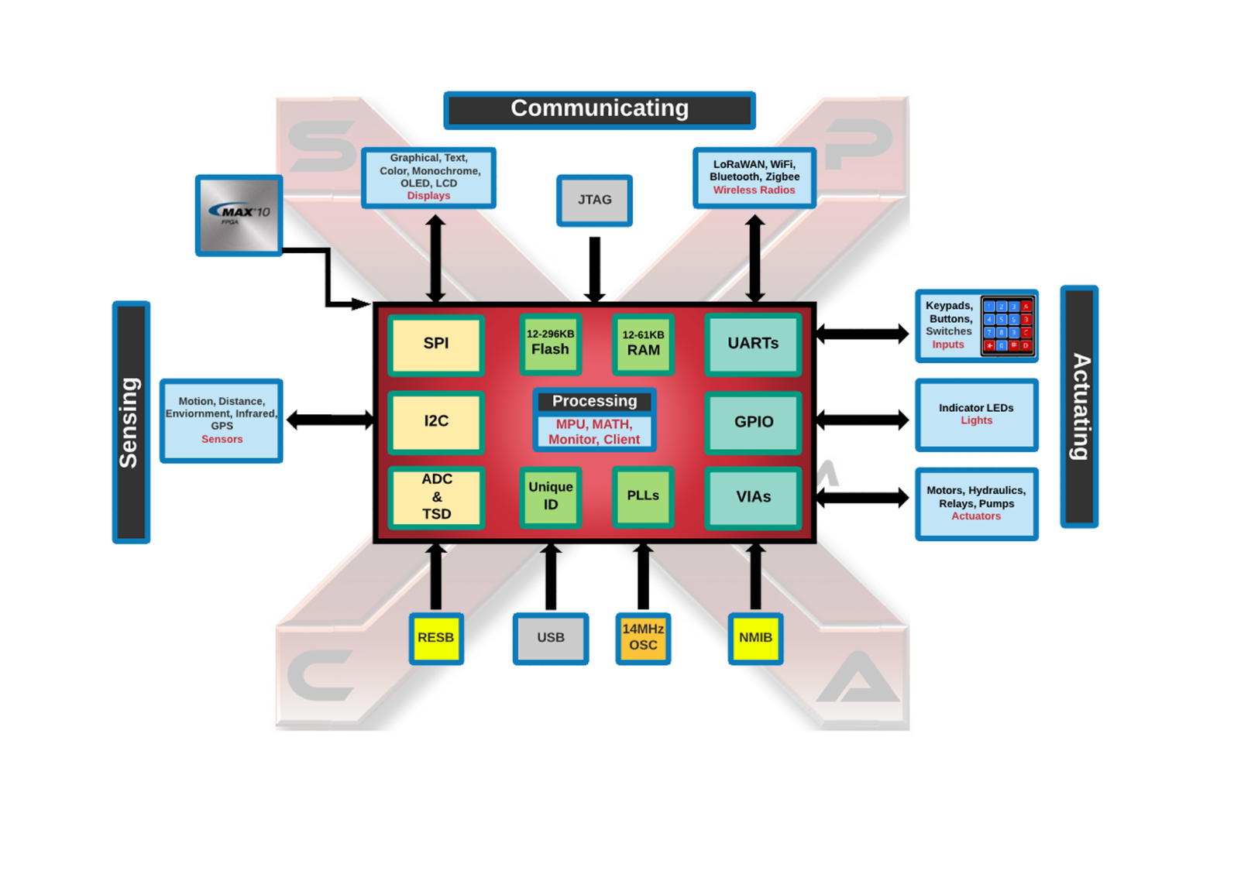
Embedded Intelligence Technology

Slide 8
Questions?
Future Contact Info:
Email – info@WesternDesignCenter.com
Phone – 480.962.4545

